Slide 1
Chapter 3: Selections

Slide 2
The boolean Type and Operators
Often in a program you need to compare two values, such as whether i is greater than j. Java provides six comparison operators (also known as relational operators) that can be used to compare two values. The result of the comparison is a Boolean value: true or false.
boolean b = (1 > 2);

Slide 3
Relational Operators

Slide 4
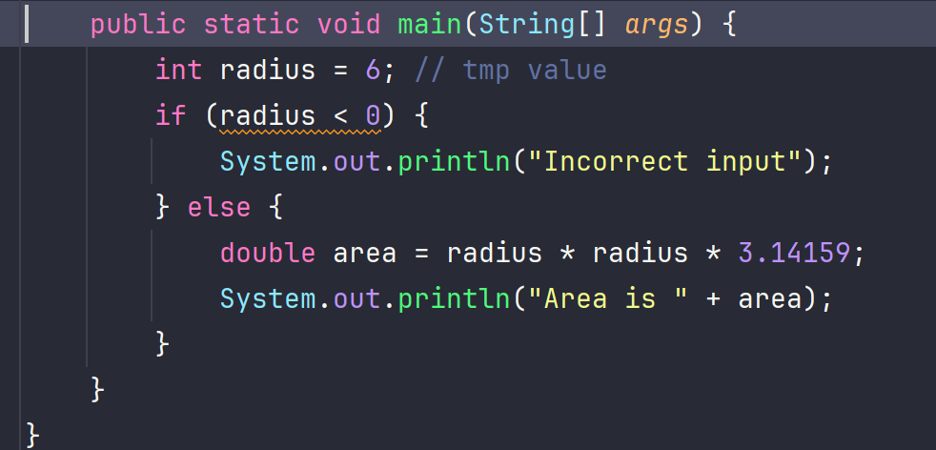
Example: ComputeArea with Error Handling
selection statements: statements that let you choose actions with alternative courses

Slide 5
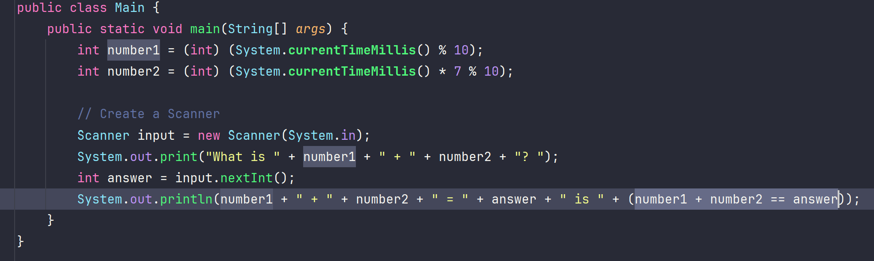
Listing 3.1 AdditionQuiz.java

Slide 6
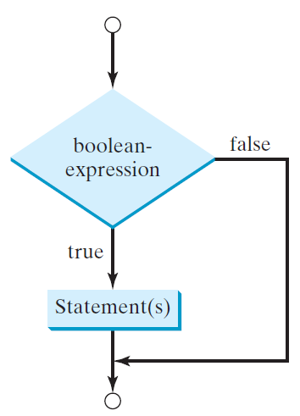
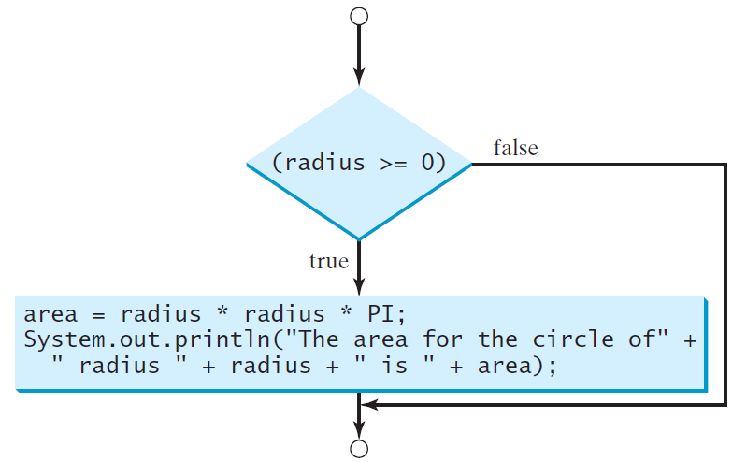
One-way if Statements
if (radius >= 0) {
area = radius * radius * PI;
System.out.println("The area"
+ " for the circle of radius "
+ radius + " is " + area);
}
Syntax: if (boolean-expression) {
statement(s);
}

Slide 7
Use cases with IF statement?
See Listing 3.2 SimpleIfDemo.
Check if number is even or odd.
Check grade letter based on score.
Set button if on/off, etc.

Slide 8
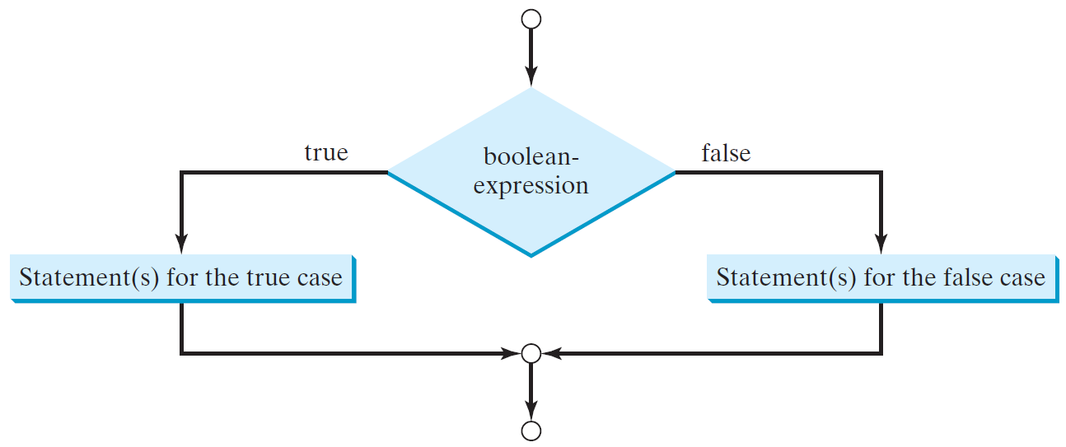
The Two-way if Statement
Syntax: if (boolean-expression) {
statement(s)-for-the-true-case;
}
else {
statement(s)-for-the-false-case;
}

Slide 9
Multiple Alternative if Statements

Slide 10
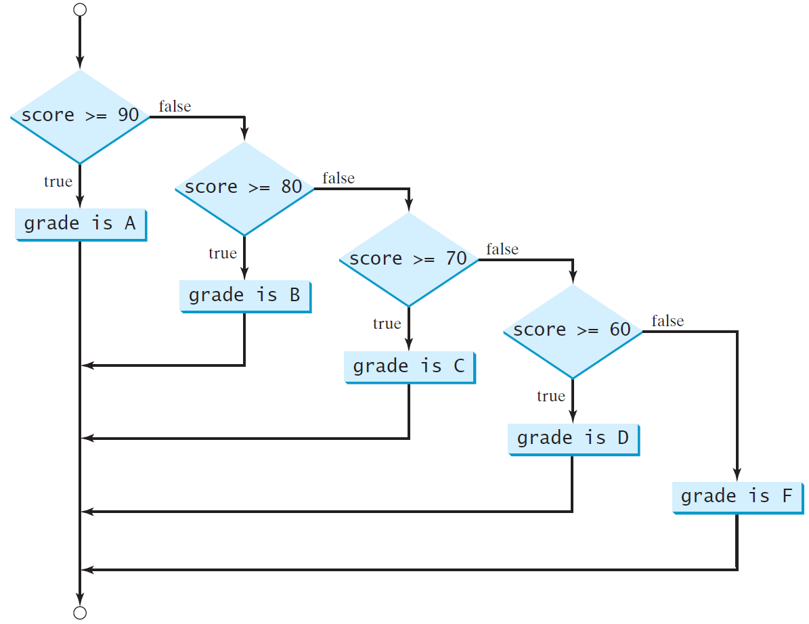
Multi-Way if-else Statements

Slide 11
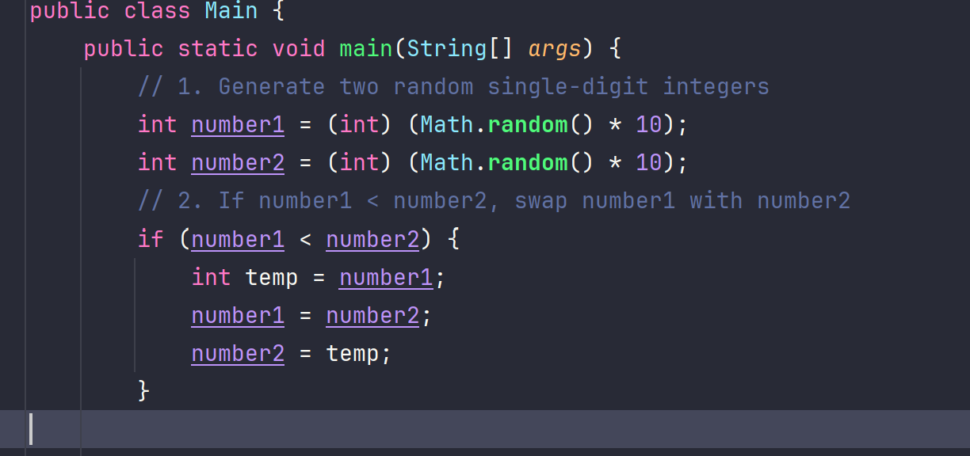
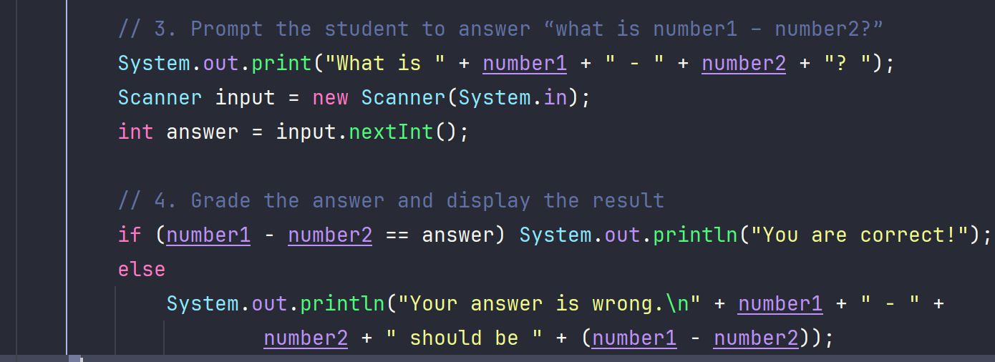
Listing 3.3 SubstractionQuiz.java
Note: See also example Listing 3.4 ComputeAndInterpretBMI, and Listing 3.5 ComputeTax

Slide 12
Logical Operators
Operator | Name | Description
! | not | logical negation
&& | and | logical conjunction
|| | or | logical disjunction
^ | exclusive or | logical exclusion

Slide 13
Truth Table for Operator !
p | !p | Example (assume age = 24, weight = 140)
true | false | !(age > 18) is false, because (age > 18) is true.
false | true | !(weight == 150) is true, because (weight == 150) is false.

Slide 14
Truth Table for Operator &&
p₁ | p₂ | p₁ && p₂ | Example (assume age = 24, weight = 140)
false | false | false | (age <= 18) && (weight < 140) is false, because both conditions are both false.
false | true | false
true | false | false | (age > 18) && (weight > 140) is false, because (weight > 140) is false.
true | true | true | (age > 18) && (weight >= 140) is true, because both (age > 18) and (weight >= 140) are true.

Slide 15
Truth Table for Operator ||
p₁ | p₂ | p₁ || p₂ | Example (assume age = 24, weihgt = 140)
false | false | false
false | true | true | (age > 34) || (weight <= 140) is true, because (age > 34) is false, but (weight <= 140) is true.
true | false | true | (age > 14) || (weight >= 150) is false, because (age > 14) is true.
true | true | true

Slide 16
Truth Table for Operator ^
p₁ | p₂ | p₁ ^ p₂ | Example (assume age = 24, weight = 140)
false | false | false | (age > 34) ^ (weight > 140) is true, because (age > 34) is false and (weight > 140) is false.
false | true | true | (age > 34) ^ (weight >= 140) is true, because (age > 34) is false but (weight >= 140) is true.
true | false | true | (age > 14) ^ (weight > 140) is true, because (age > 14) is true and (weight > 140) is false.
true | true | false

Slide 17
Examples
System.out.println("Is " + number + " divisible by 2 and 3? " +
((number % 2 == 0) && (number % 3 == 0)));
System.out.println("Is " + number + " divisible by 2 or 3? " +
((number % 2 == 0) || (number % 3 == 0)));
System.out.println("Is " + number +
" divisible by 2 or 3, but not both? " +
((number % 2 == 0) ^ (number % 3 == 0)));

Slide 18
Use cases for Logical Operator?
See examples in Textbook:
- 3.6 TestBooleanOperators
- 3.7 LeapYear
- 3.8 Lottery

Slide 19
Problem: Determining Leap Year?
This program first prompts the user to enter a year as an int value and checks if it is a leap year.
A year is a leap year if it is divisible by 4 but not by 100, or it is divisible by 400.
(year % 4 == 0 && year % 100 != 0) || ( year % 400 == 0)

Slide 20
Problem: Lottery
Write a program that randomly generates a lottery of a two-digit number, prompts the user to enter a two-digit number, and determines whether the user wins according to the following rule:
If the user input matches the lottery in exact order, the award is $10,000.
If the user input matches the lottery, the award is $3,000.
If one digit in the user input matches a digit in the lottery, the award is $1,000.

Slide 21
switch Statements
switch (status) {
case 0: compute taxes for single filers;
break;
case 1: compute taxes for married file jointly;
break;
case 2: compute taxes for married file separately;
break;
case 3: compute taxes for head of household;
break;
default: System.out.println("Errors: invalid status");
System.exit(1);
}

Slide 22
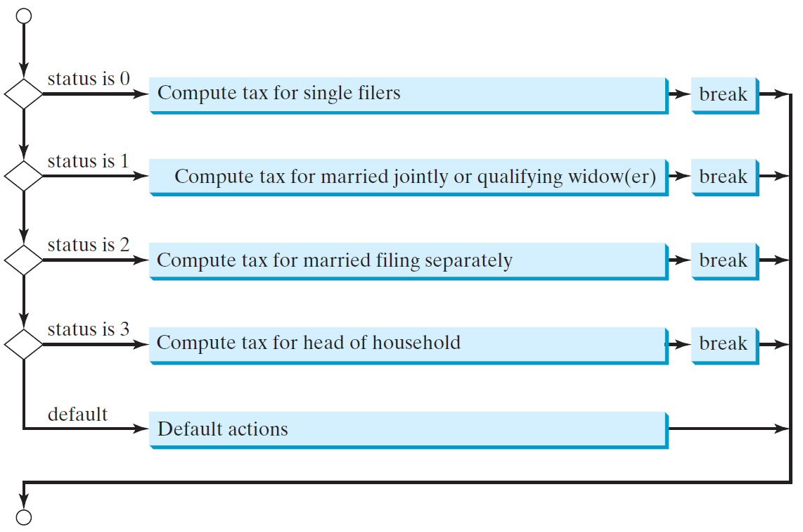
switch Statement Flow Chart

Slide 23
switch Statement Rules
The switch-expression must yield a value of char, byte, short, or int type and must always be enclosed in parentheses.
switch (switch-expression) {
case value1: statement(s)1;
break;
case value2: statement(s)2;
break;
…
case valueN: statement(s)N;
break;
default: statement(s)-for-default;
}
The value1, ..., and valueN must have the same data type as the value of the switch-expression. The resulting statements in the case statement are executed when the value in the case statement matches the value of the switch-expression. Note that value1, ..., and valueN are constant expressions, meaning that they cannot contain variables in the expression, such as 1 + x.

Slide 24
switch Statement Rules
The keyword break is optional, but it should be used at the end of each case in order to terminate the remainder of the switch statement. If the break statement is not present, the next case statement will be executed.
switch (switch-expression) {
case value1: statement(s)1;
break;
case value2: statement(s)2;
break;
…
case valueN: statement(s)N;
break;
default: statement(s)-for-default;
}
The default case, which is optional, can be used to perform actions when none of the specified cases matches the switch-expression.
When the value in a case statement matches the value of the switch-expression, the statements starting from this case are executed until either a break statement or the end of the switch statement is reached.

Slide 25
Trace switch statement
Suppose day is 2:
switch (day) {
case 1:
case 2:
case 3:
case 4:
case 5: System.out.println("Weekday"); break;
case 0:
case 6: System.out.println("Weekend");
}

Slide 26
Trace switch statement
Match case 2
switch (day) {
case 1:
case 2:
case 3:
case 4:
case 5: System.out.println("Weekday"); break;
case 0:
case 6: System.out.println("Weekend");
}

Slide 27
Trace switch statement
Fall through case 3
switch (day) {
case 1:
case 2:
case 3:
case 4:
case 5: System.out.println("Weekday"); break;
case 0:
case 6: System.out.println("Weekend");
}

Slide 28
Trace switch statement
Fall through case 4
switch (day) {
case 1:
case 2:
case 3:
case 4:
case 5: System.out.println("Weekday"); break;
case 0:
case 6: System.out.println("Weekend");
}

Slide 29
Trace switch statement
Fall through case 5
switch (day) {
case 1:
case 2:
case 3:
case 4:
case 5: System.out.println("Weekday"); break;
case 0:
case 6: System.out.println("Weekend");
}

Slide 30
Trace switch statement
Encounter break
switch (day) {
case 1:
case 2:
case 3:
case 4:
case 5: System.out.println("Weekday"); break;
case 0:
case 6: System.out.println("Weekend");
}

Slide 31
Trace switch statement
Exit the statement
switch (day) {
case 1:
case 2:
case 3:
case 4:
case 5: System.out.println("Weekday"); break;
case 0:
case 6: System.out.println("Weekend");
}

Slide 32
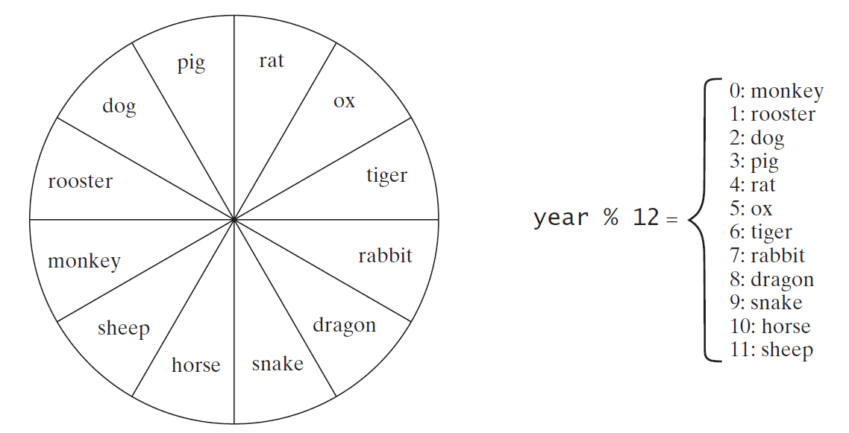
Problem: Chinese Zodiac
Write a program that prompts the user to enter a year and displays the animal for the year.

Slide 33
Conditional Expressions
if (x > 0)
y = 1
else
y = -1;
is equivalent to
y = (x > 0) ? 1 : -1;
(boolean-expression) ? expression1 : expression2
Ternary operator
Binary operator
Unary operator

Slide 34
Conditional Operator
if (num % 2 == 0)
System.out.println(num + “is even”);
else
System.out.println(num + “is odd”);
System.out.println(
(num % 2 == 0)? num + “is even” :
num + “is odd”);

Slide 35
Debugging
Logic errors are called bugs. The process of finding and correcting errors is called debugging. A common approach to debugging is to use a combination of methods to narrow down to the part of the program where the bug is located. You can hand-trace the program (i.e., catch errors by reading the program), or you can insert print statements in order to show the values of the variables or the execution flow of the program. This approach might work for a short, simple program. But for a large, complex program, the most effective approach for debugging is to use a debugger utility.

Slide 36
Debugger
Debugger is a program that facilitates debugging. You can use a debugger to
Execute a single statement at a time.
Trace into or stepping over a method.
Set breakpoints.
Display variables.
Display call stack.
Modify variables.

Slide 37
Exercises
See exercises in Textbook (page 131-133):
- 3.4 Random Month
- 3.7 Game: Multiplication Quiz
- 3.14 Game: heads or tails
- 3.17 Game: scissor, rock, paper

